Slide 1

Computer History

Slide 2
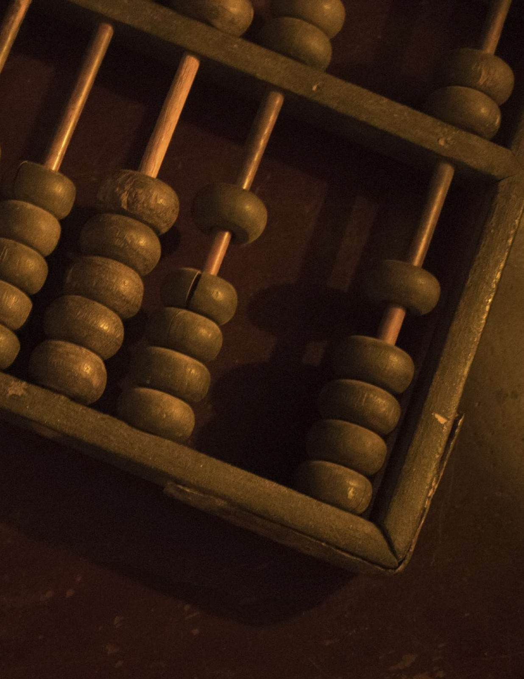


ABACUS
4th Century B.C
The abacus, a simple counting aid, may have been invented in Babylonia ( now Iraq) in the fourth century B.C.
This device allows users to make computations using a system of sliding beads arranged on a rack. Considered the first computer.

Slide 3
First Computer
Abacus

Slide 4



ABACUS
4th Century B.C
In 1642, the French mathematician and philosopher Blaise Pascal invented a calculating device that would come to be called the "Adding Machine".
One of the first and earliest mechanical devices used for calculating was the Pascaline.

Slide 5
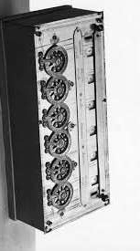


BLAISE PASCAL (1623 - 1662)
Originally called a "numerical wheel calculator" or the "Pascaline", Pascal's invention utilized a train of 8 moveable dials or cogs to add sums of up to 8 figures long. As one dial turned 10 notches - or a complete revolution - it mechanically turned the next dial.
Pascal's mechanical Adding Machine automated the process of calculation. Although slow by modern standards, this machine did provide a fair degree of accuracy and speed.

Slide 6
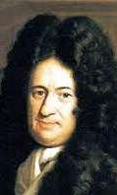



Gottfried Wilhelm von Leibniz
The Leibniz Calculator (or stepped reckoner) was a digital mechanical calculator invented by the German mathematician Gottfried Wilhelm Leibniz around 1673 and completed in 1694.
The name comes from the translation of the German term for its operating mechanism, Staffelwalze, meaning "stepped drum".
It was the first calculator that could perform all four arithmetic operations.

Slide 7
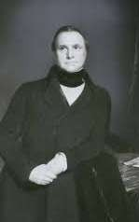



CHARLES BABBAGE (1791 - 1871)
Born in 1791, Charles Babbage was an English mathematician and professor.
In 1822, he persuaded the British government to finance his design to build a machine that would calculate tables for logarithms. Called the “Difference Engine.” Device was to calculate numbers to 20th place and print them at 4 digits per minute.

Slide 8
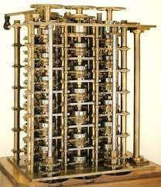
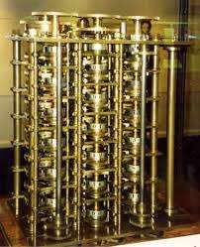
Charles Babbage
1822 Babbage's Difference Engine

Slide 9
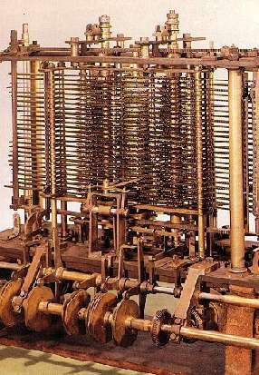
Analytical Engine
(1833)
Used to perform a variety of calculations by following a set of instructions or programs stored on punch cards.
Machine only designed but never built.

Slide 10
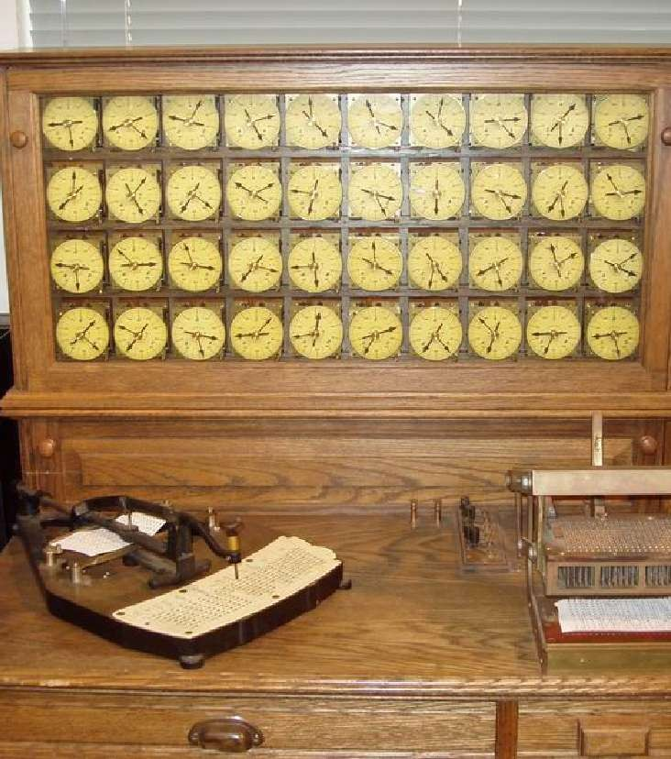





Tabulating Machine
Used electricity rather than mechanical gears. Holes representing information to be tabulated were punched in cards.
The location of each hole represented a specific piece of information (male vs. female). Cards inserted into the machine and metal pins used to open and close electrical circuts
If the circuit was closed, a computation
was increased by one.

Slide 11
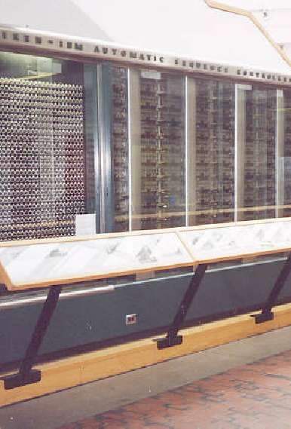


Howard Aiken
(1900 - 1973)
The Mark I did transform Babbage's dream into reality and did succeed in putting IBM's name on the forefront of the computer industry.
From 1944 on, modern computers would forever be associated with digital intelligence.

Slide 12
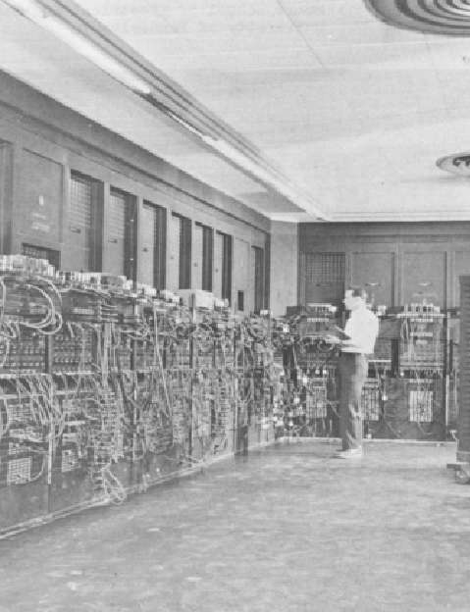

ENIAC - 1946
Electronic Numerical Integrator And Computer - a machine that computed at speeds 1,000 times faster than the Mark I was capable of only 2 years earlier.
Using 18,00-19,000 vacuum tubes, 70,000 resistors and 5 million soldered joints this massive instrument required the output of a small power station to operate it.

Slide 13
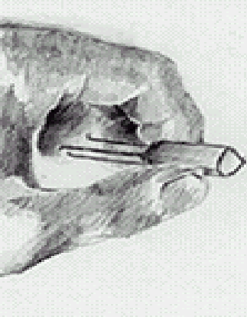
TRANSISTOR (1947)
This tiny device had a huge impact on and extensive implications for modern computers. In 1956, the transistor won its creators the Noble Peace Prize for their invention.
In the laboratories of Bell Telephone, John Bardeen, Walter Brattain and William Shockley discovered the "transfer resistor"; later labeled the transistor.

Slide 14
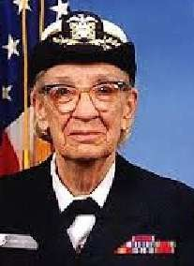
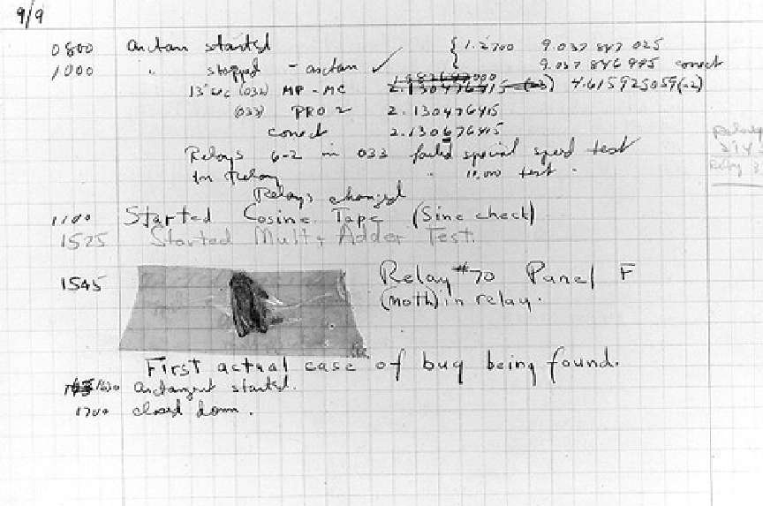
First Computer Bug
- Grace Hopper

Slide 15
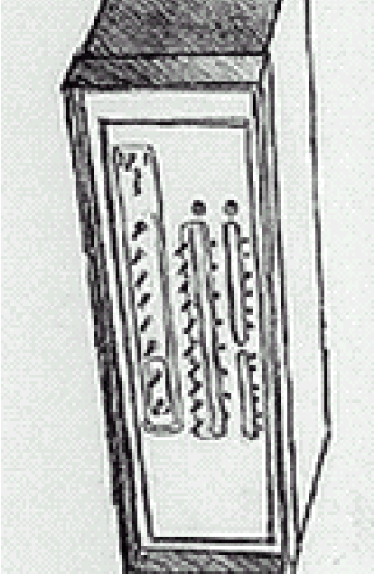
ALTAIR
1975
The invention of the transistor made computers smaller, cheaper and more reliable. Therefore, the stage was set for the entrance of the computer into the domestic realm. In 1975, the age of personal computers commenced.
ALTAIR FACTS:
No Keyboard
No Video Display No Storage Device
Under the leadership of Ed Roberts the Micro Instrumentation and Telemetry Company (MITS) wanted to design a computer 'kit' for the home hobbyist.

Slide 16

IBM (PC)
(1981)
On August 12, 1981 IBM announced its own personal computer.
sing the 16 bit Intel 8088 microprocessor, allowed for increased speed and huge amounts of memory.
Unlike the Altair that was sold as unassembled computer kits, IBM sold its "ready-made" machine through retailers and by qualified salespeople.
For the first time, small companies and individuals who never would have imagined owning a "personal" computer were now opened to the computer world.

Slide 17




MACINTOSH
(1984)
IBM's major competitor was a company lead by Steve Wozniak and Steve Jobs; the Apple Computer Inc.
The "Lisa" was the result of their competitive thrust.
This system differed from its predecessors in its use of a "mouse" - then a quite foreign computer instrument - in lieu of manually typing commands.
However, the outrageous price of the Lisa kept it out of reach for many computer buyers.

Slide 18

MACINTOSH
(1984)
Apple's brainchild was the Macintosh. Like the Lisa, the Macintosh too would make use of a graphical user interface.
Introduced in January 1984 it was an immediate success.
The GUI (Graphical User Interface)
made the system easy to use.

Slide 19
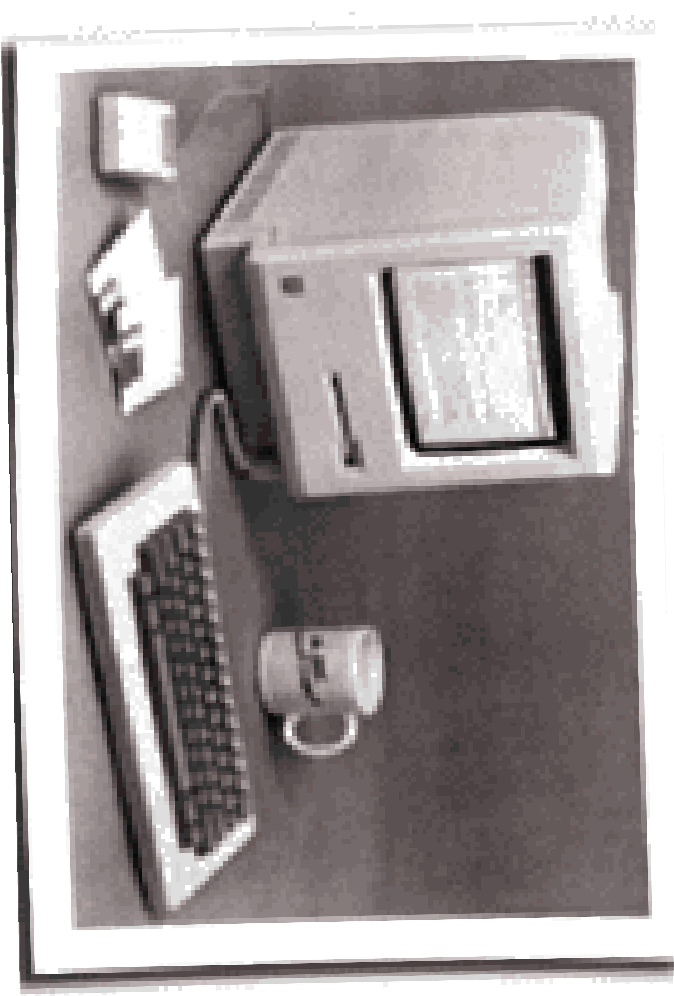


MACINTOSH
(1984)
The Apple Macintosh debuts in 1984. It features a simple, graphical interface, uses the 8- MHz, 32-bit Motorola 68000 CPU, and has a built-in 9-inch B/W screen.
Cost $2,495

